Slide 1
Color Trend Mining Application
Prepared for Designer X

Slide 2
Problem Statement
Designer X hopes to take inspiration from recent runway shows’ colour stories for their new Resort line. However, because there are so many collections to view, and colour stories evolve from season to season, Designer X would like help automating the research process.

Slide 3
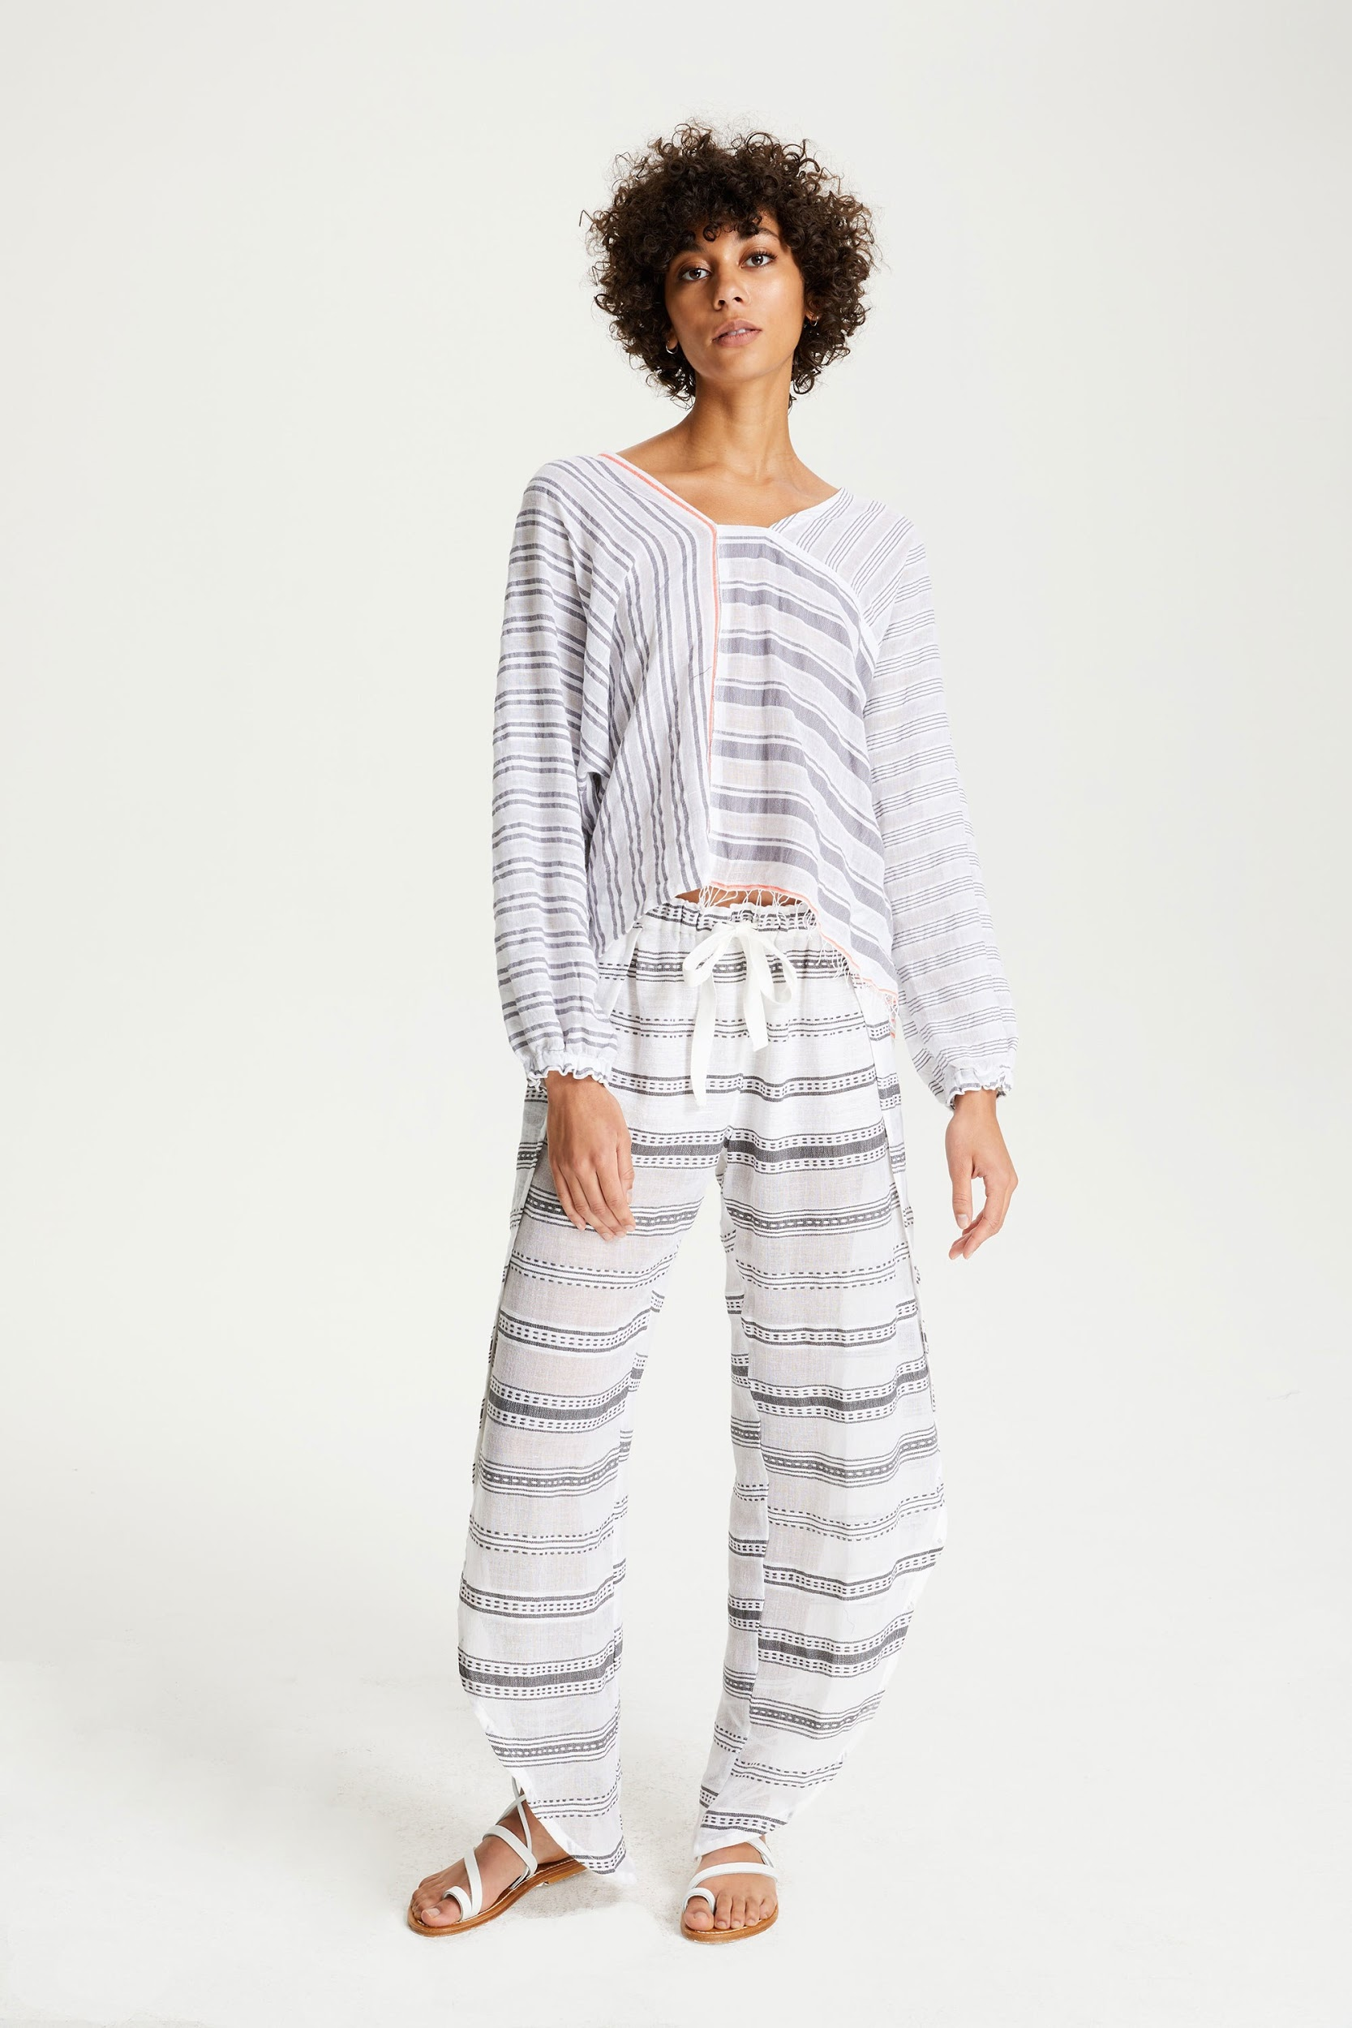
Data Available
Designer X has found vogue.com to be a rich source of inspiration photos. Designer X is particularly interested in the Lem Lem Resort collections from 2017 and 2018; however, they would like to be able to easily access the colour stories of any show available on the site.
LemLem Resort ‘18, vogue.com

Slide 4
Data Collection
We began by developing a simple web scraper that will take in the designer, season, and year of interest and return a folder containing all images from the collection at the highest resolution available.
Developing the web scraper required manual inspection of the html and css on vogue.com. The regular expressions used in this scraper match the LemLem collections, as well as some other. However, deeper investigation reveals that there is no consistency in the formatting of asset links, meaning we will either need to use a more permissive regex, or perform more manual inspection.

Slide 5
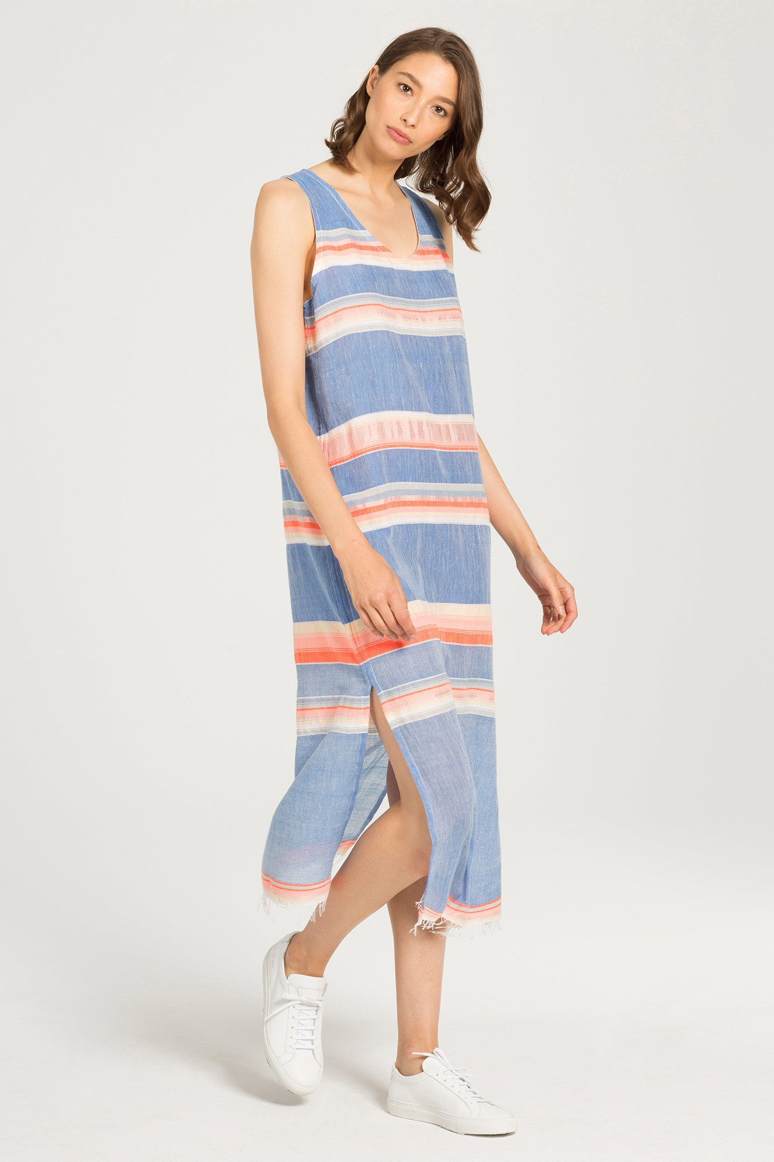
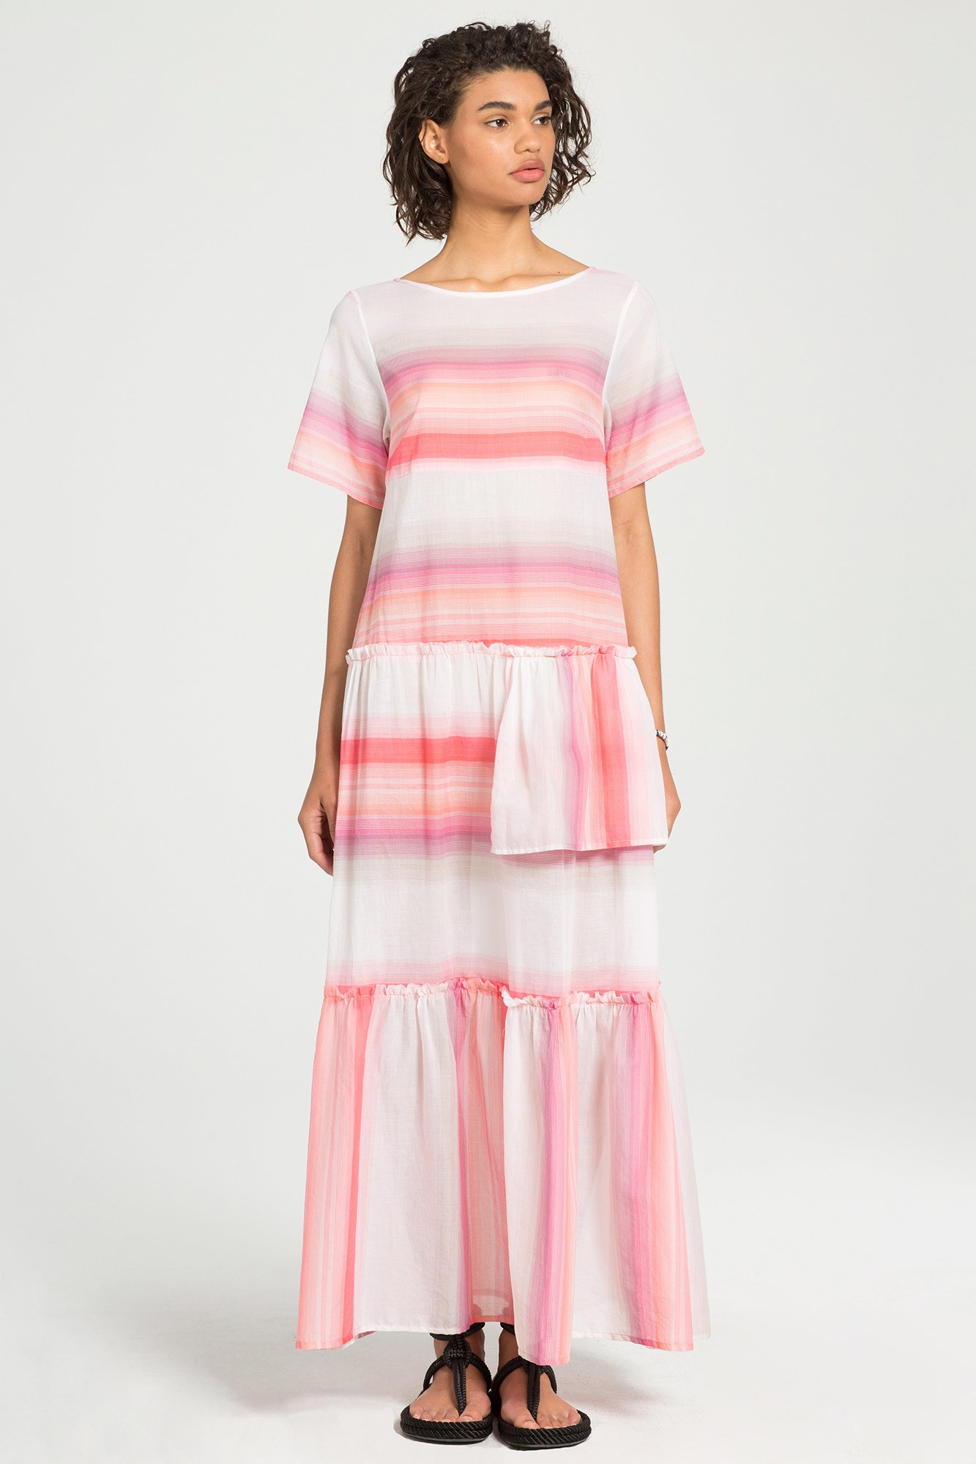
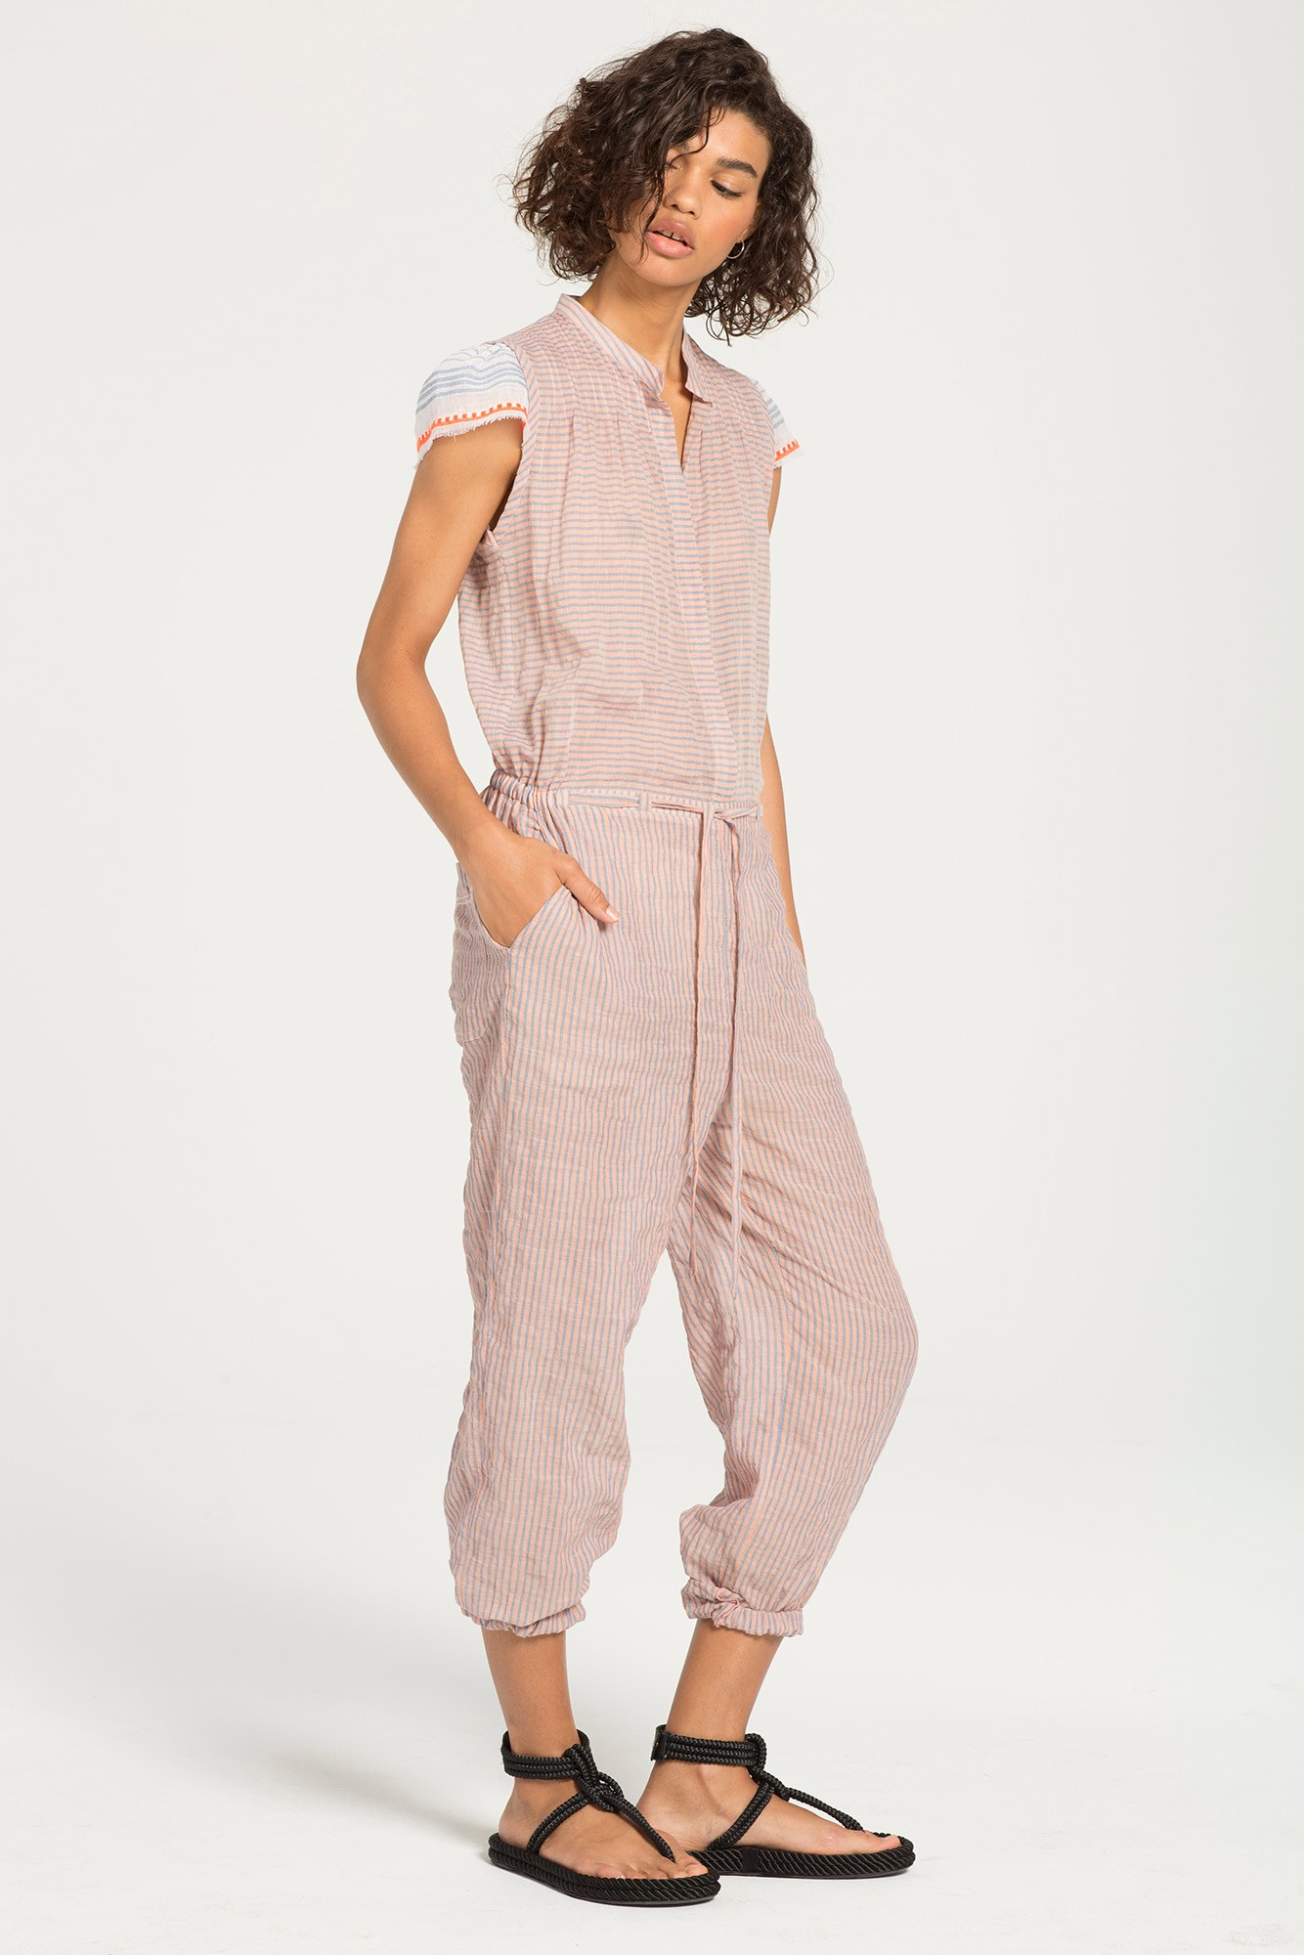
The Pictures
Look photos are comprised of background, face and hair, and garment.
LemLem Resort ‘17, vogue.com

Slide 6
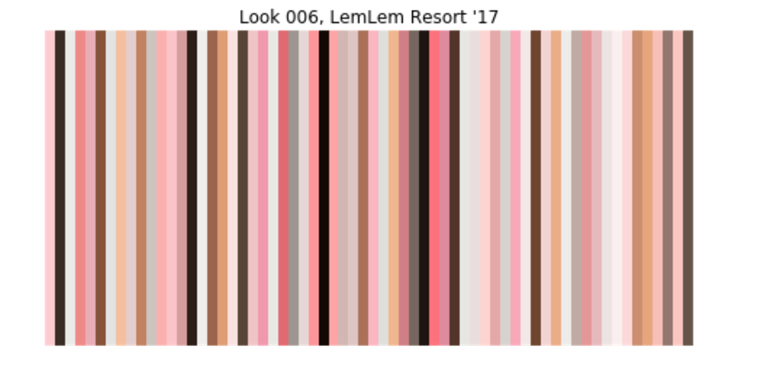
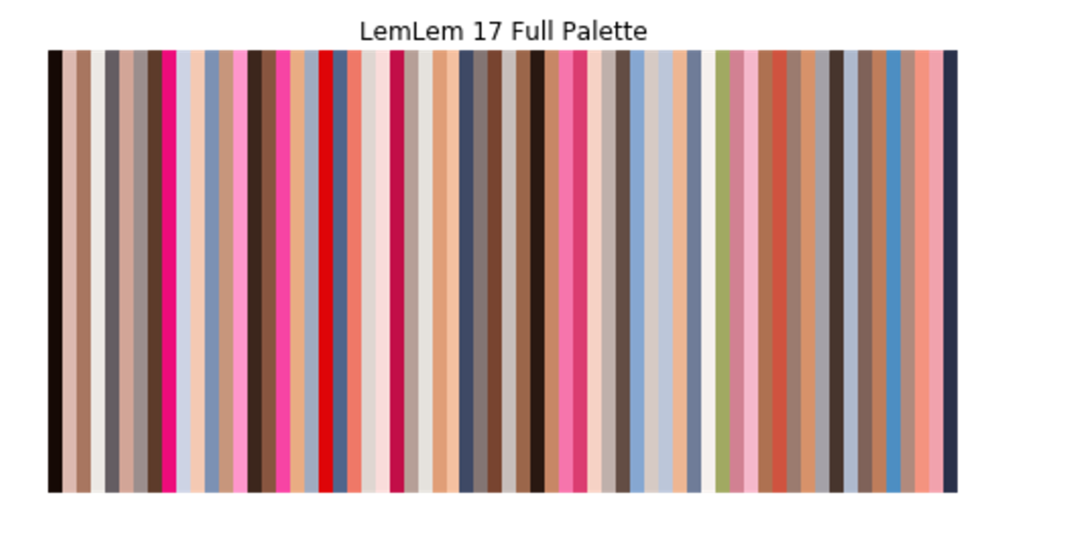
Colour extractions, first pass
Using a clustering algorithm called kMeans, we were able to extract color palettes from individual looks, as well as the collection as a whole.

Slide 7
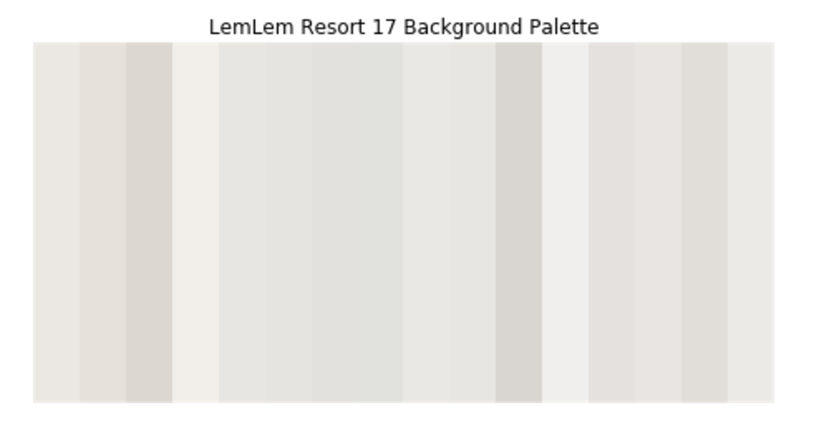
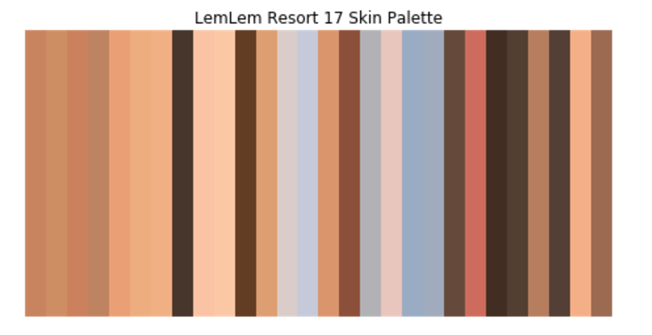
Identifying background and skin colors
In order to zero in on garment colors, we needed to identify colors that made up the background and the models’ skin.
Identifying background colors was a simple matter of sampling color near the edges of the image. To identify skin, we used OpenCV’s facial recognition algorithm, then sampled from the identified face to generalize about skin color.

Slide 8
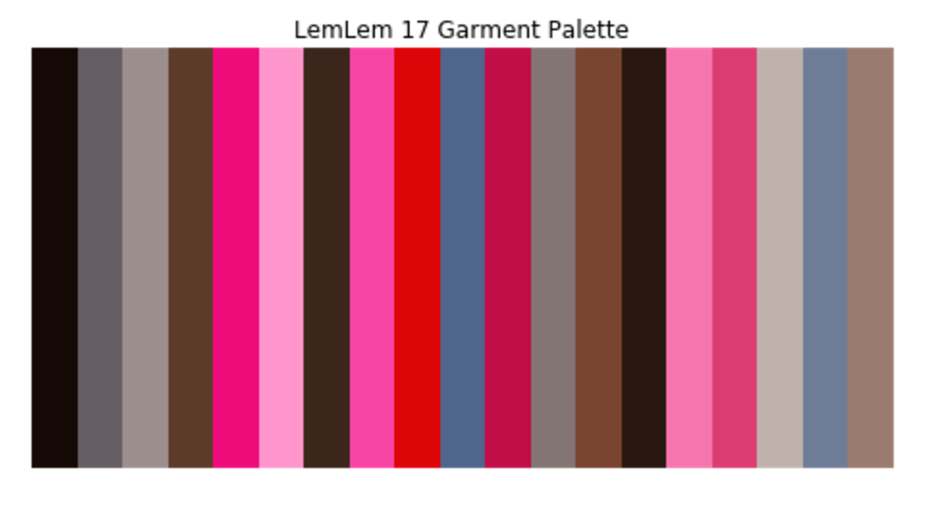
Final Garment Palette
Removing colors from the full palette that were within a threshold of the background and skin palettes resulted in a more focused garment palette:

Slide 9
